Slide 1
Company A Sales Analysis
Presented to: EXCO
Presented by: Justin Chan
Date: 16th November 2017

Slide 2
Content
Background
Purpose, Tasks and Context
Performance Overview
Sales Analysis – Team, Product, Campaign
Potential Issues
Recommendations
Improving Sales
Potential Issues
Quarterly Sales Analysis

Slide 3
Background
Purpose
Provide data-driven insights to support acceleration strategy
Tasks
Analyze historical sales performance and identify potential issues
Context
Periods covered (6 quarters):
Dec 2015 – Aug 2016 (Last Financial Year)
Dec 2016 – Aug 2017 (Current Financial Year)
Teams: A and B
Campaigns: March and July

Slide 4
Background
Context (con’t)
Previous existing products:
Product 1: Withdrawn January 2017
Product 2: Continued sales throughout
Product 4: Withdrawn April 2017
New products:
Product A: Launched February 2016
Product B: Launched March 2016
Product C: Launched August 2016
Product D: Launched January 2017
Product E: Launched April 2017

Slide 5
Performance Overview - Highlights
Income Growth is flat
Less Policies Sold
Withdrawal of high volume Products 1 and 4
Increase in Average Income Per Policy Sold
Characteristics of newer Products A, B, C and D
 | Last Financial Year (Dec 2015 – Aug 2016) | Current Financial Year (Dec 2016 – Aug 2017) | Percentage Change
Income | $1.35m | $1.36m | + 1.0%
Policies Sold | 2257 | 750 | -66.8%
Average Income Per Policy Sold | $599 | $1,819 | +203.9%

Slide 6
Performance Overview

Slide 7
Performance Overview

Slide 8
Team Performance - Highlights
Last Financial Year, Team A sold more policies and generated more income.
Current Financial Year, Team B sold slightly more policies and generated more income.
Average Income Per Policy Sold overall higher for Team B
 | Last Financial Year (Dec 2015 – Aug 2016) |  | Current Financial Year (Dec 2016 – Aug 2017)
 | Team A | Team B | Team A | Team B
Income | $774,525 | $576,492 | $395,086 | $969,302
Policies Sold | 2,125 | 132 | 344 | 406
Average Income Per Policy Sold | $364 | $4,367 | $1,149 | $2,387

Slide 9
Team Performance - Income

Slide 10
Team Performance – Policies Sold

Slide 11
Team Performance – Average Income Per Policy Sold

Slide 12
Team Performance – Product Level
Comments on Income
Team A generated more income from previously existing products (Products 1, 2 and 4)
Team B generated more income from newly launched products (Products A – E )
Product A’s sale by Team B accounted for 28.7% of total income for last and current financial year.

Slide 13
Team Performance – Product Level
Comments on Average Income per Policy Sold
Large discrepancies in Average Income per Policy Sold for certain products
For Product A
Team A: $2,486
Team B: $11,813

Slide 14
Team Performance – Product Level
Comments on Policies Sold
Large discrepancies in Policies Sold
For Product 1, 2 and 4, Team A sells much more than Team B.
For newly launched products, Team B sells more than Team A.

Slide 15
Product Performance

Slide 16
Product Performance – Changes in Product Mix

Slide 17
Product Matrix
Product A (Team B)
Team B sells Products A and B at a higher average ‘Price’ than Team A.
High
Price (Average Income Per Policy Sold)
Product A (Team A), C, D
Product 2, B (Team B)
Mid
Product C
Product B (Team A), E
Product 1, 4
Low
Both Products withdrawn.
Only Team A sold these products
Team B never sold these.
Low
Mid
High
Volume (Policies Sold)

Slide 18

Product Performance – Product 1
Comments for Product 1
Only Team A sold this product.
Sold in multiples of 10 policies each month.

Slide 19
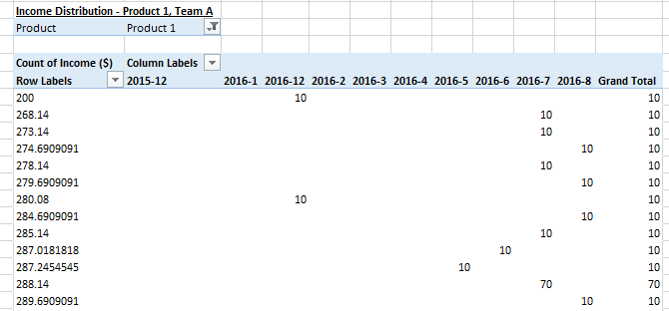
Product Performance – Product 1 (Multiple of 10)
Comments for Product 1
More evidence that identical contracts are sold in multiples of 10
Various income points in each period.
Is a single policyholder sold multiple policies?
Require policyholder data to find out.
Are there any caps on Sum Assureds?
Verify with product specs
What is the commission structure to the agent?
Per policy sold?

Slide 20
Product Performance – Product 2

Slide 21
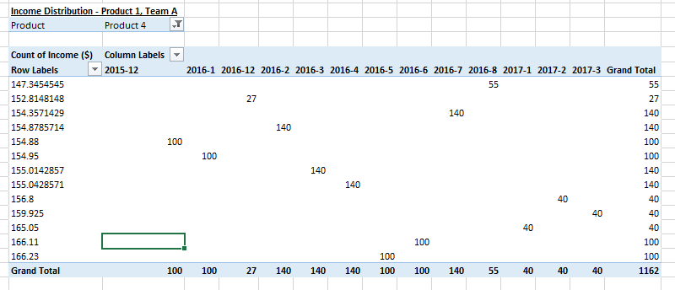
Product Performance – Product 4 (Single Income Point)
Comments for Product 4
Only Team A sold this product.
All policies sold in each month at a single income point.
Investigate as per Product 1’s Multiple of 10 Issue

Slide 22
Product Performance – Product 1 and 4 Associations
Comments for Product 1 and 4 Associations
Monthly Incomes of Product 1 and 4 tend to track each other.
If income increased for Product 1 in current month, it is likely Product 4 also increased in income in the same month.
Similarly, if one decreased in the current month, the other also tends to decrease in the same month.
Future investigations for other products and metrics.

Slide 23
Product Performance – Product A

Slide 24
Product Performance – Product B

Slide 25
Product Performance – Product C

Slide 26
Product Performance – Products D and E

Slide 27
Campaign Performance – March Campaigns
Comments for March Campaigns
From Feb 2016 to March 2016
Income ↑ 0.1%
Policies Sold ↑ 0.4%
From Feb 2017 to Mar 2017
Income ↑ 2.0%
Policies Sold ↑ 1.3%

Slide 28
Campaign Performance – July Campaigns
Comments for July Campaigns
From Jun 2016 to Jul 2016
Income ↑ 30.1%
Policies Sold ↑ 35.8%
From Jun 2017 to Jul 2017
Income ↑ 141.5%
Policies Sold ↑ 169.4%
July campaigns more effective than March campaigns.

Slide 29
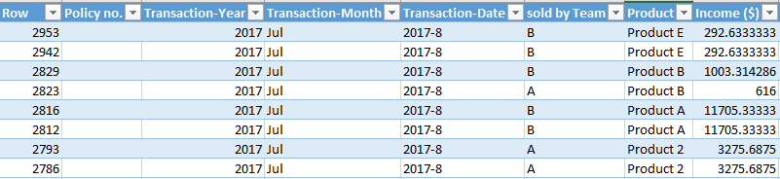

Potential Issues
Missing Policy Numbers
8 policies with missing policy numbers – excluded from sales analysis
Minimal impact (0.3% of policies sold, 1.2% of income)
Inconsistencies in Data Fields
Transaction-Year and Transaction-Month do not correspond to Transaction-Date
We used Transaction-Year and Transaction-Month in the sales analysis

Slide 30
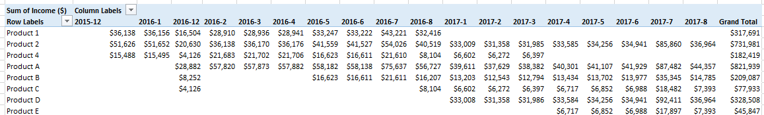
Potential Issues
Monthly Income Patterns

Slide 31
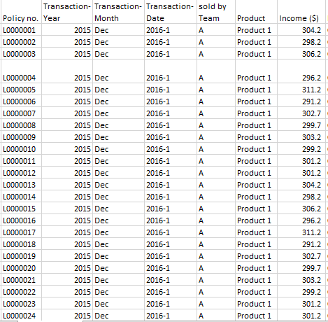
Potential Issues
Repeated Policy Income Sequences

Slide 32
Recommendations - Improving Sales
Create Products to address High Volume, Low Price segment
Previously addressed by Product 1 and 4
Understand why Products 1 and 4 were withdrawn.
Create Opportunities to sell more products
Create riders to main products for upselling
Perform holistic client assessment to identify hidden needs and objectives; then recommend suitable products.
Widen sales channel beyond the agency
Online sales – simple protection product, low price, targeted at the younger digital consumer
Direct Marketing – Partner with specialists with possible capital support (eg. ReMark/SCOR)
Bancassurance – Partner with suitable bank; Costly and subject to bidding war with other insurers.

Slide 33
Recommendations - Improving Sales
Address Team Performance Differences
Understand reasons why Average Income Per Policy Sold is lower for Team A.
Consider sales commission structure, customer segments, training, license/qualifications
Review March campaign
Determine if another month or customer segment is more effective.
Improve sales process
Simplified underwriting for simple products.
Streamline insurance application forms
Improve Know-Your-Customer (KYC) process
Validate customers using Singapore Government’s MyInfo System to manage citizen’s identities.
Ensure that product literature for clients is easy to understand and jargon-free.

Slide 34
Recommendations - Potential Issues
Investigate issues with relevant departments
Product 1 – Multiple of 10 Issue
Product 4 – Single Income Point
Missing Policy Numbers
Inconsistencies in Data Fields
Monthly Income Patterns
Repeated Policy Income Sequences
Assessing Impact
Impact on areas of reporting
Operational risk reporting
Raise appropriate change requests, apply remedies etc.
Implement checks for future quarterly sales analysis

Slide 35
Recommendations – Quarterly Sales Analysis
Include as part of EXCO quarterly review meeting agenda.
Define the Deliverable(s)
Obtain feedback on this analysis and metrics used
Include other or more detailed analysis, metrics or data visualizations
Compare against forecasts (ie. Actual vs Expected)
New potential issues arising
Implementation
Identify resources (manpower, data) and timelines
Document process
Distribution
Other interested stakeholders in addition to EXCO.
Confidentiality level

